Slide 1
Amateur Tech Licensing Course
Corky Searls – AF4PM
10-2018

Slide 2
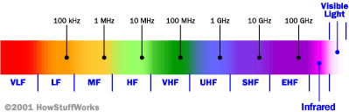

The Electromagnetic Spectrum

Slide 3
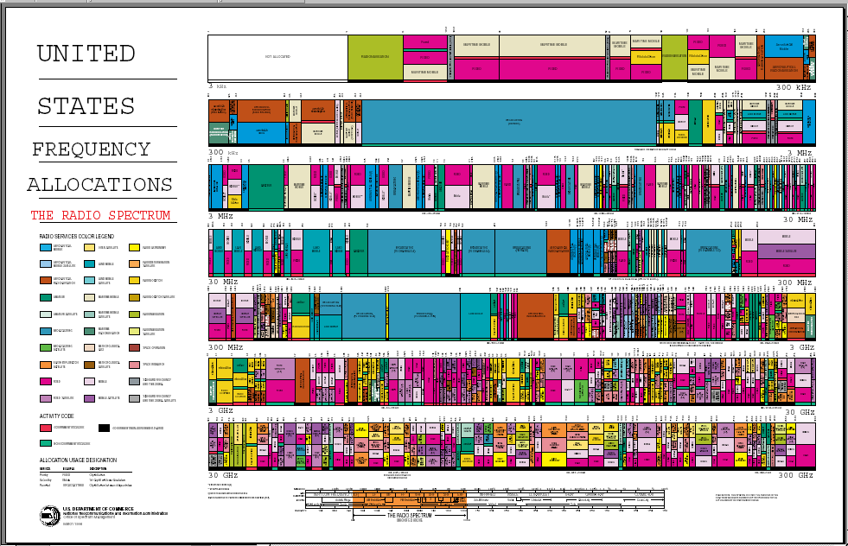

Slide 4
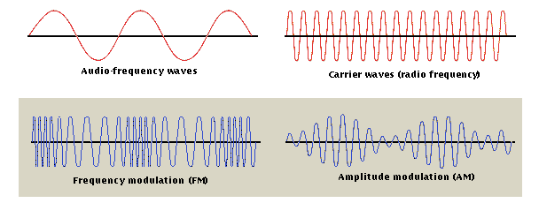
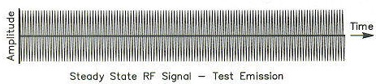
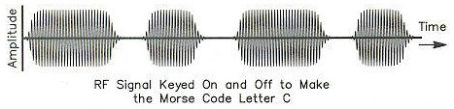
How Radio Waves Carry Information
Notes:
Radio waves can be modified to carry information in many ways. Three ways are shown and described below.
The “Audio-frequency waves” might be the electrical signal produced by a microphone when you speak into it. It would also be the electrical signal sent to the speaker to produce the voice you hear coming from the radio.
The “Carrier waves” shown below are the radio waves produced by the transmitter at the frequency you have your radio set to.
The transmitter modifies the carrier waves by combining it with the audio frequency waves to produce a new radio wave.
One way to do this is by changing the carrier frequency. This is known as frequency modulation (FM). A picture of the resulting wave is shown.
Another way of modifying the carrier wave’s amplitude (i.e., height). This is known as amplitude modulation (AM). A picture of the resulting wave is shown.
These modified waves thus carry the audio frequency signal as they are transmitted from antenna to antenna through the air. When this modulated signal gets to the receiver, the receiver pulls out the carrier wave and is left with the original audio frequency wave which it can send to the speaker.
Another way a radio wave can carry information is to just turn it on and off. This is the way Morse code is sent. Pictures of the carrier wave and the signal you get when you turn it on and off to send the letter C.

Slide 5
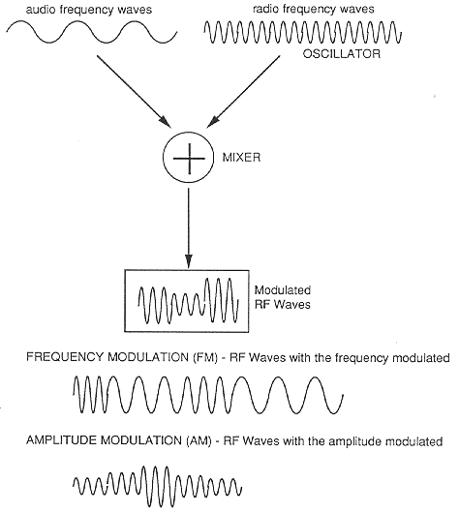
Modulation
OSCILLATORS--Used in transmitters to produce radio frequency (RF) energy from DC voltages.
MODULATION--Means "to change". In radio modulation, used to change the frequency or amplitude (size) of radio waves.

Slide 6
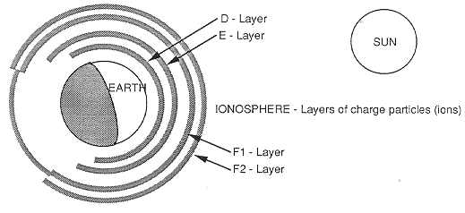
The Earths Ionosphere

Slide 7
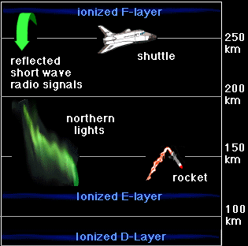
The Ionosphere Layers Exist within the Thermosphere

Slide 9
Why does the FCC have an Amateur Radio Service?
Volunteer service – (community service and disaster help). A Scout does a good turn daily – here is another way.
International goodwill – A great way to talk to people in far away lands.
Experimentation – If you want, you can build your own radio equipment, and many hams build their own antennas. Some hams have come up with new inventions, such as MF, SSB, Packet Radio, Automated Position Reporting Systems (APRS).
Communication skills – Because only one person can talk at a time, you learn how to listen!
Trained Operators – Expanding the number of trained operators.

Slide 10



How Radio Waves Carry Sounds or Information
Frequency Modulation - FM radio stations and hundreds of other wireless technologies (including the sound portion of a TV signal, cordless phones, cell phones, etc.) use frequency modulation. The advantage to FM is that it is largely immune to static. In FM, the transmitter's sine wave frequency changes very slightly based on the information signal.
Amplitude Modulation - Both AM radio stations and the picture part of a TV signal use amplitude modulation to encode information. In amplitude modulation, the amplitude of the sine wave (its peak-to-peak voltage) changes. So, for example, the sine wave produced by a person's voice is overlaid onto the transmitter's sine wave to vary its amplitude.
Pulse Modulation - In PM, you simply turn the sine wave on and off. This is an easy way to send Morse code. PM is not that common, but one good example of it is the radio system that sends signals to radio-controlled clocks in the United States. One PM transmitter is able to cover the entire United States!

Slide 11
Units of Measure
Greek Name | Abbreviation
Terra | T | 1,000,000,000,000 | 10¹²
Giga | G | 1,000,000,000 | 10⁹
Mega | M | 1,000,000 | 10⁶
Kilo | k | 1,000 | 10³
Hecto | h | 100 | 10²
Deca | da | 10 | 10¹
(unit) | U | 1 | 10⁰
Deci | d | 0.1 | 10⁻¹
Centi | c | 0.01 | 10⁻²
Milli | m | 0.001 | 10⁻³
Micro | u | 0.000001 | 10⁻⁶
Nano | n | 0.000000001 | 10⁻⁹
Pico | p | 0.000000000001 | 10⁻¹²

